Slide 1
NGO Funding Analysis

Slide 2
Problem Statement
Helping an NGO to choose the countries based on various factors like child morality, gdp, income etc.,

Slide 3
Approach
Getting the PCA components on data.
Finding the No of PCA’s which will explain the variance.
Drawing the elbow curve to find the optimal k.
Performing the K means analysis to get the clusters.
Visualizing the variance distribution.

Slide 4
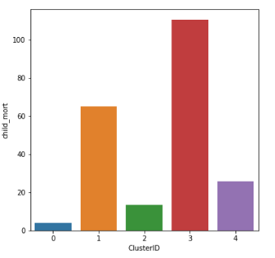
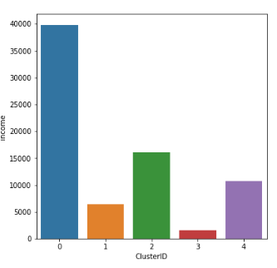
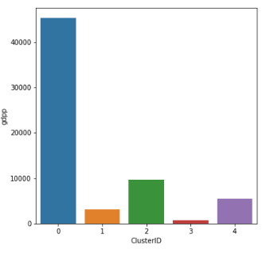
Factors Analysis
In the below bar graph the child mortality is very high for counties in Cluster-3 &1. which menace the newly born is getting effected by premature complications. This generally occurs with the low income countries. So, NGO can choose countries from cluster 3 & 1 for their service.

Slide 5
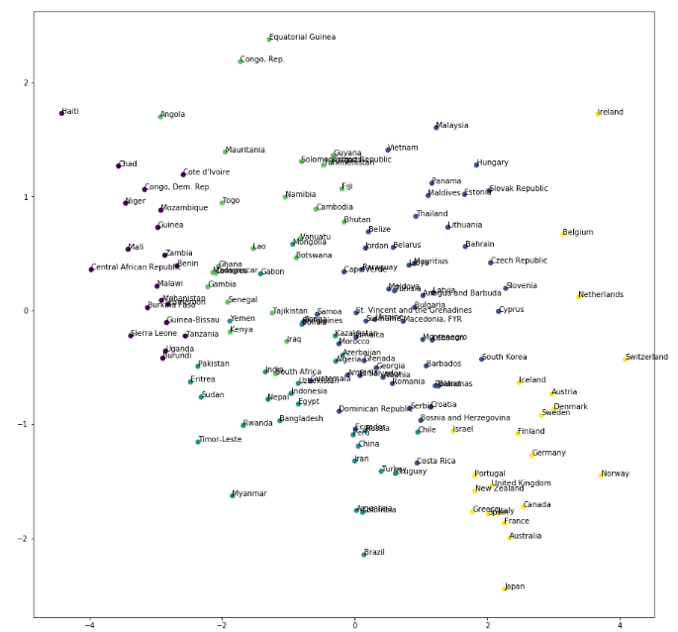
Countries Spread For two principal components with 5 clusters
d

Slide 6
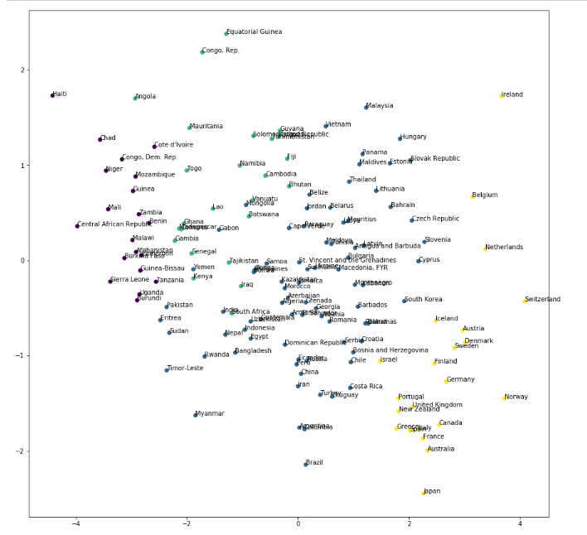
Countries Spread For two principal components with 4 clusters

